Slide 1
BATCH 2 week 1 report

Slide 2
SUMMARY OF THE WEEKS ACTIVITIES
Orientation by the first batch students
Fabrication of the second nozzle
Fabrication of the second case

Slide 3
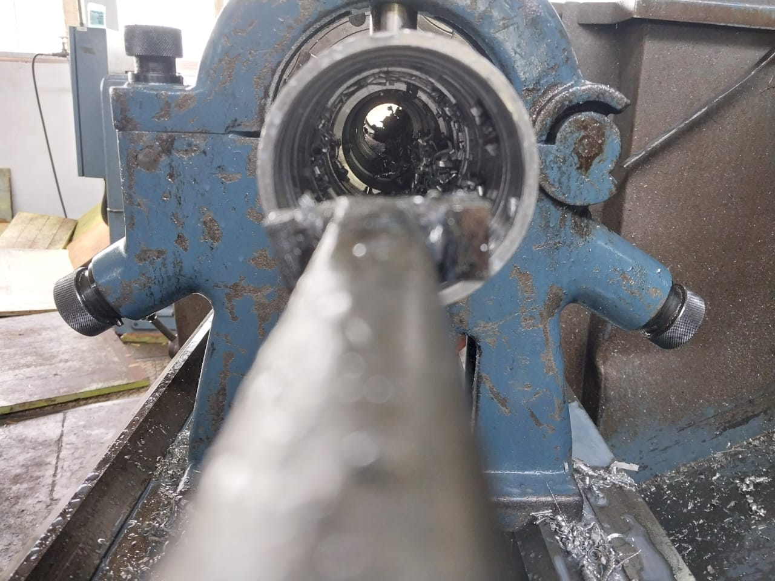
Fabrication of the second casing
The casing is 80% done.
Casting as an option of fabrication has been discarded.
Two weeks estimate, to complete the other cases.

Slide 4
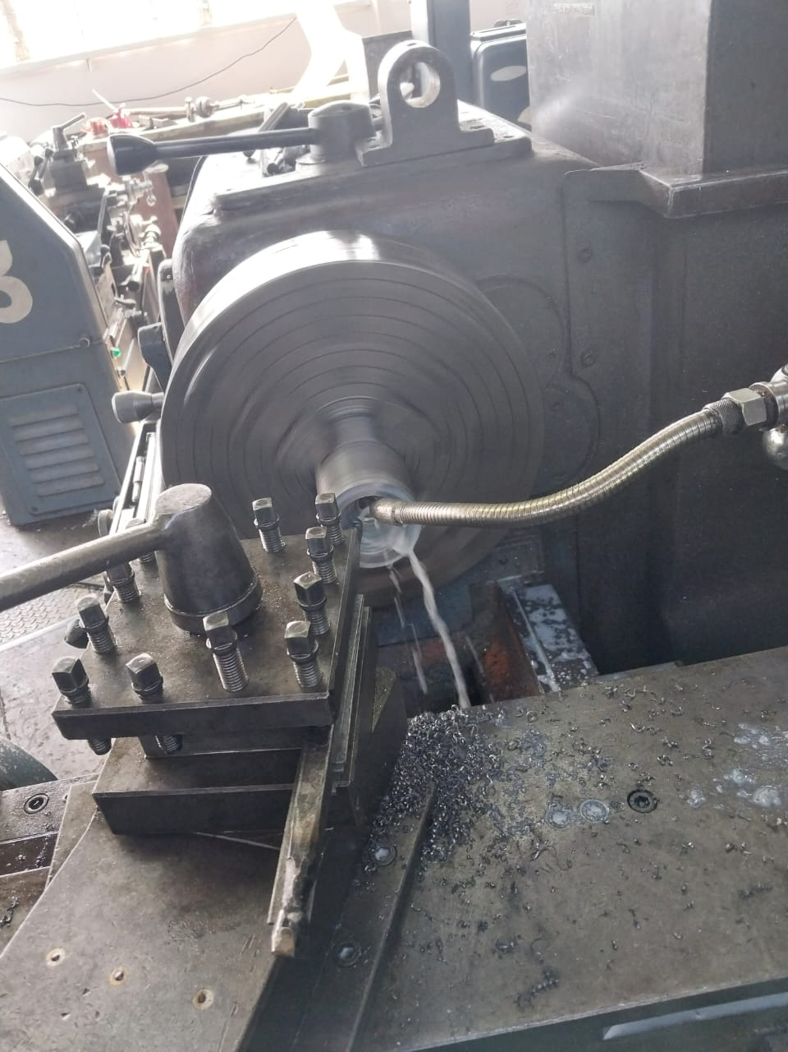
Fabrication of the nozzle
The second nozzle is 95% done at the moment
The estimated duration for fabrication of the remaining 2nozzles is 1 ½ weeks

Slide 5
Next weeks objectives:
Completion of the second case
Cook additional cartridges of KNSB
Improve on the load cell’s code
Fully assemble one motor to be used for the static test

